Slide 1
Competitor Analysis
Multifleet, OdoDrive and CLM

Slide 2
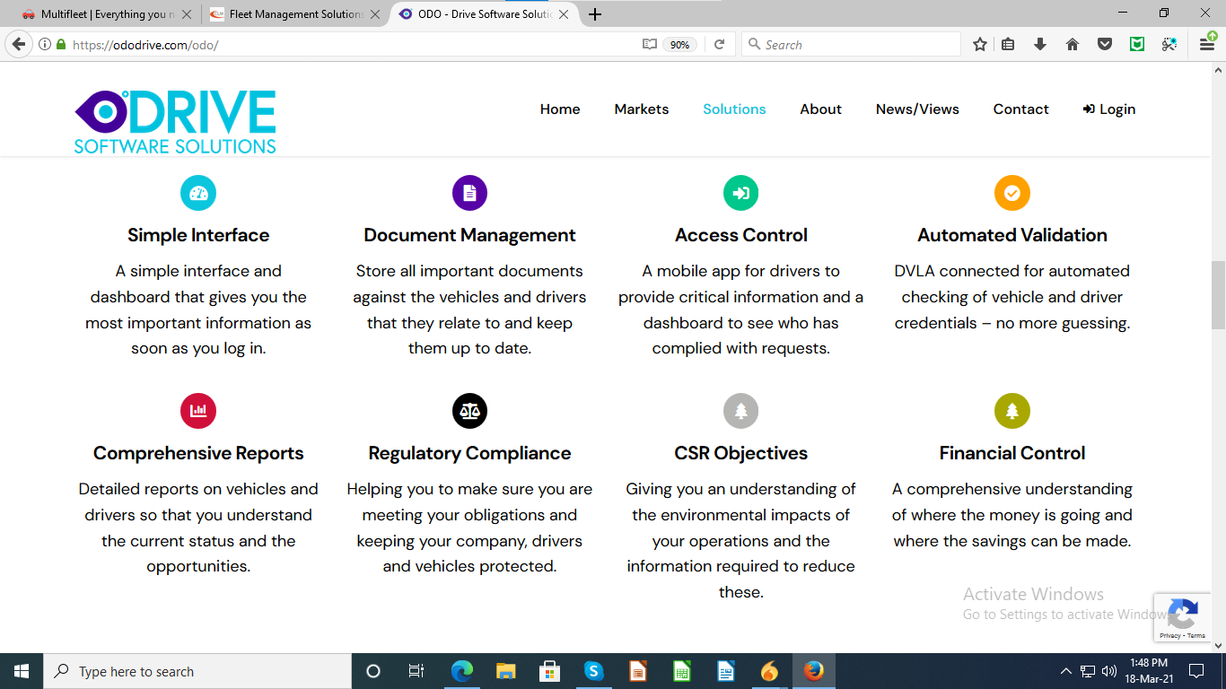
OdoDrive
List of some solutions/features provided by OdoDrive - states some requirements of clients that can be catered by odo

Slide 3
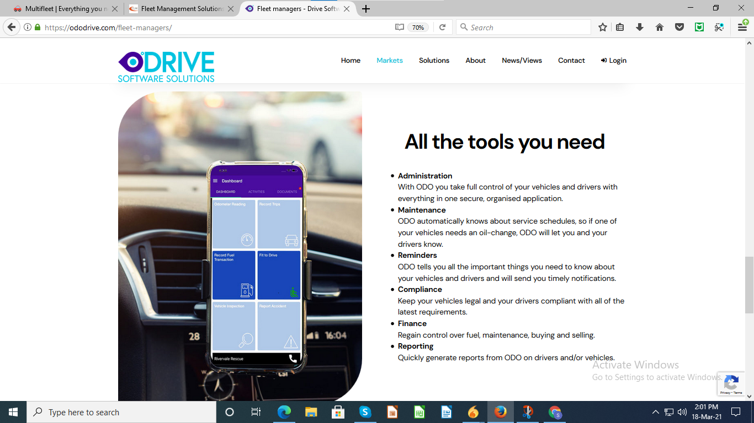
OdoDrive
A demo screen of application showing a simple-to-use interface.

Slide 4
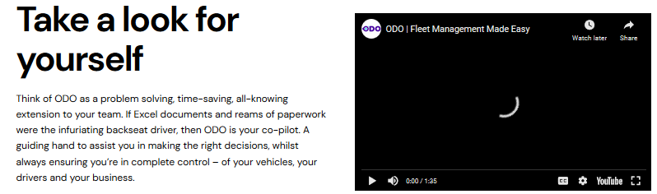
OdoDrive
A live YouTube video - To engage the user

Slide 5


OdoDrive
Transparent navigation bar in MF makes it less readable.

Slide 6
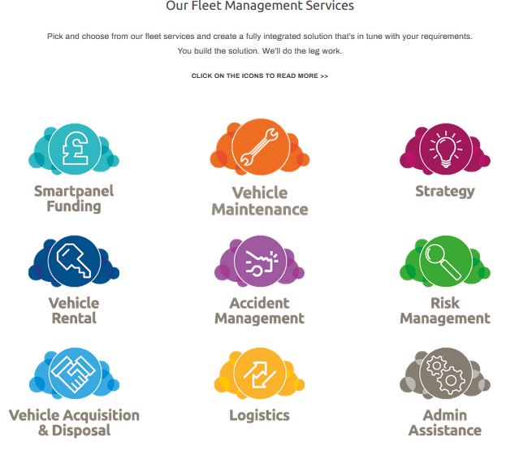
CLM
Display of fleet management services as icons - looks more appealing.

Slide 7
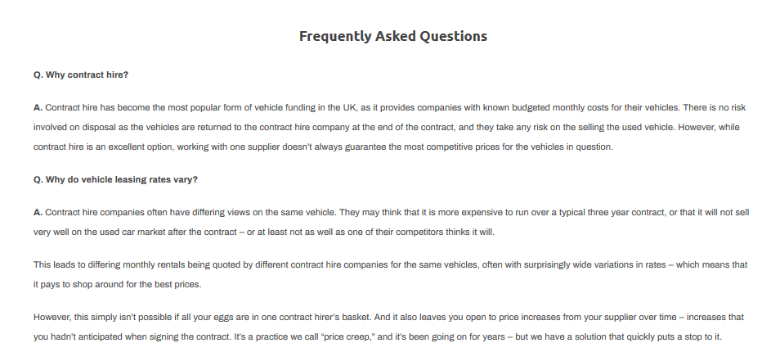
CLM
FAQ’s - Can clear some general questions instantly instead of waiting for a CLM executive to connect on a query

